Slide 1
Netflix data analysis
CROP PRODUCTION ANALYSIS
coffee analysis

Slide 2
introduction
This project aims to analyze a comprehensive dataset on crop production in India, focusing on key factors like crop types, seasons, and regional variations. Using Tableau, we will visualize trends and insights, helping to predict future crop yields and identify critical influencers of agricultural productivity. The visualizations will support data-driven decision-making for optimizing crop production. This analysis is vital for enhancing efficiency and sustainability in the agriculture sector.

Slide 3
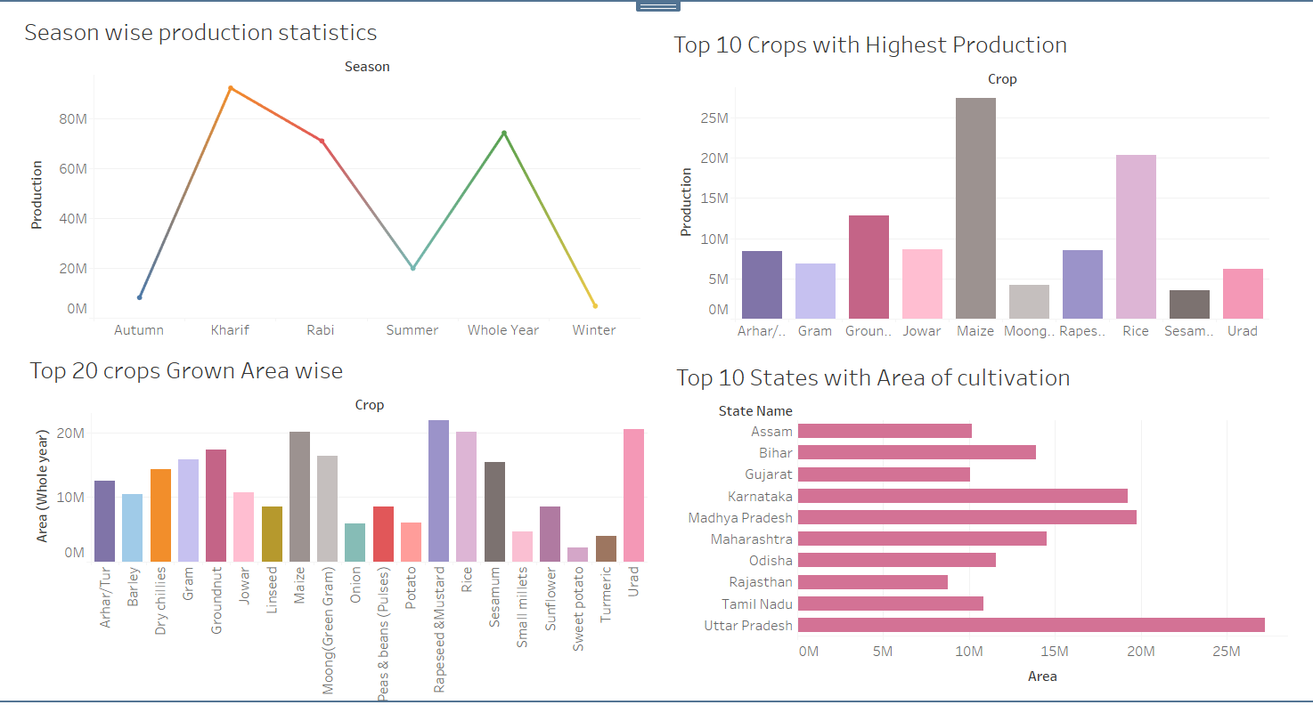
Crop production dashboard

Slide 4
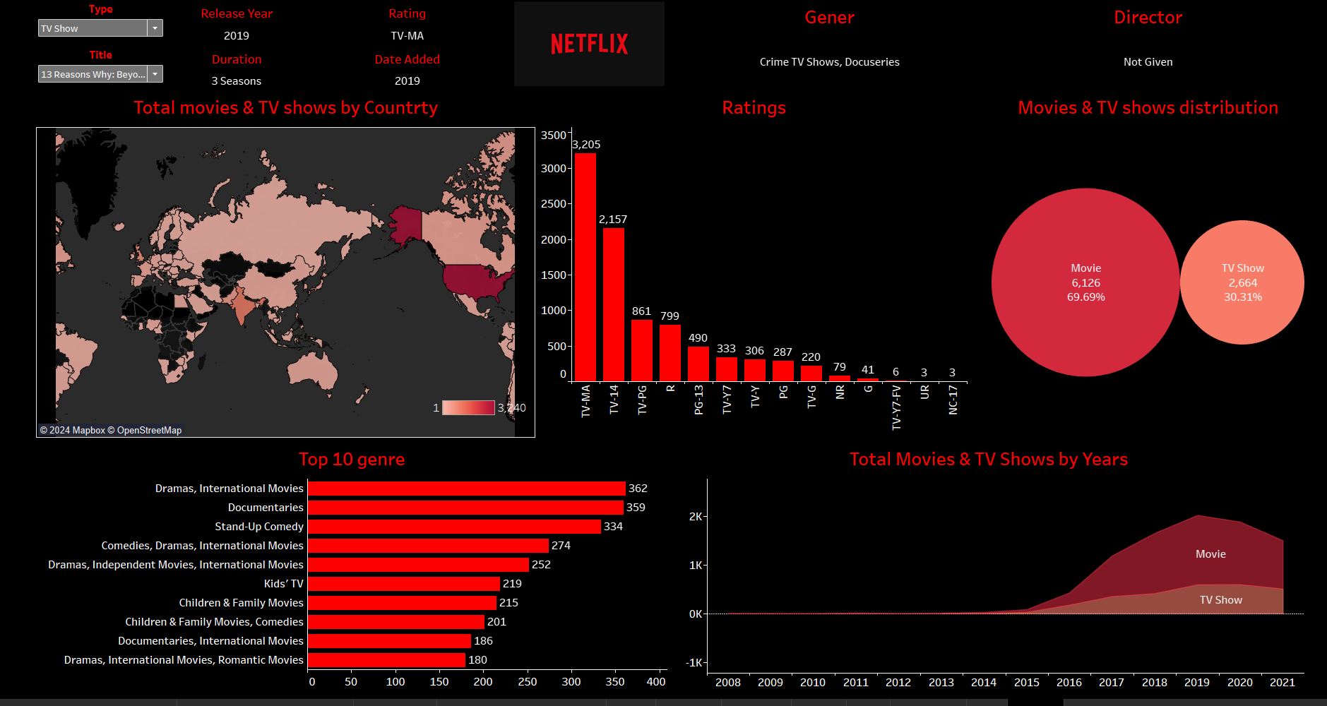
Netflix analysis dashboard

Slide 5
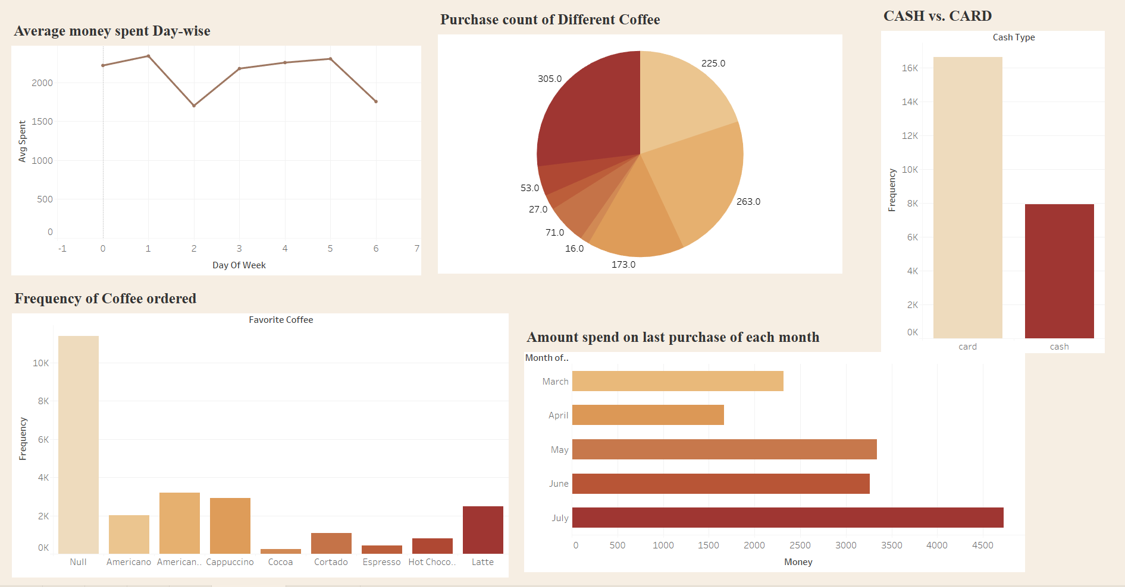
Coffee sales dashboard

Slide 6
THANK YOU

